Slide 1
Applet in JAVA

Slide 2
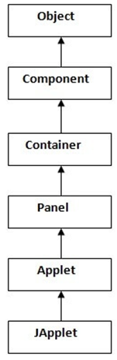
Applet
An applet is
A special type of program that is embedded in the webpage
Using the APPLET or OBJECT tag and hosted on a web server
To generate the dynamic content
Runs inside the browser and works at client side
All applets are
Used to make the web site more dynamic and entertaining
Sub-classes (either directly or indirectly)
Of java.applet.Applet class
Applet class extends Panel
Panel class extends Container which is the subclass of Component

Slide 3
Applet
Advantages
Applets are supported by most web browser
under many platforms including Linux, Windows, Mac Os etc.
Applets have very less response time
Because it works at client side
Applets are quite secure
The size of applets is small
Making it easier to transfer over network
Drawback
Applets require a Java plug-in to execute
Applets do not support file system
Applet itself cannot run or modify any application on the local system
It cannot work with native methods of system
An applet cannot access the client-side resources

Slide 4
Important points about Applet
Applets are not stand-alone programs
JDK provides a standard applet viewer tool
Called applet viewer
Execution of an applet does not begin at main() method
Applets are small Java programs
That can be accessed on an Internet server
Transported over Internet, and
Can be automatically installed and run as a part of a webpage

Slide 5
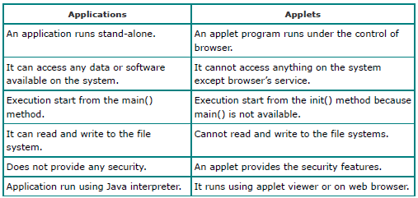
Application Vs Applet

Slide 6
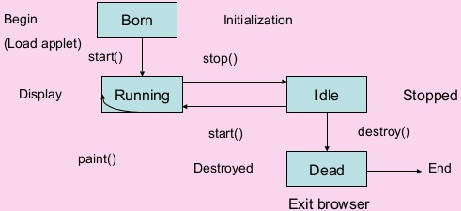
Life Cycle of a Applet
Various stages in Applet
Born state
Applet is initialized
Ready to Run
Applet is started
Running state
Applet is painted
Idle state
Applet is stopped
Dead state
Applet is destroyed

Slide 7
Lifecycle methods for Applet
For an applet
The java.applet.Applet class provides 4 life cycle methods
public void init()
Is used to initialized the Applet
It is invoked only once
public void start()
Is invoked after the init() method or browser is maximized
It is used to start the Applet
public void stop()
Is used to stop the Applet
It is invoked when Applet is stop or browser is minimized
public void destroy()
Is used to destroy the Applet
It is invoked only once
The java.awt.Component class provides 1 life cycle method
public void paint(Graphics g)
Is used to paint the Applet
It provides Graphics class object that can be used for drawing oval, rectangle, arc etc.

Slide 8
Developing an Applet Program
Steps to develop an applet program
Create an applet (java) code i.e. .java file
Compile to generate .class file
Design a HTML file with <APPLET> tag

Slide 9
How to run an Applet?
Two ways to execute an applet
By html file
By appletViewer tool (for testing purpose)

Slide 10
Example ::Applet
// Example_applet.java
import java.applet.Applet;
Import java.awt.Graphics;
public class Example_applet extends Applet
{
public void paint (Graphics g)
{
g.drawString ( "welcome", 150, 150);
}
}
Save the above program: Example_applet.java
Compile : > javac Example_applet.java
Note: Class must be public because its object is created by Java Plugin software
that resides on the browser

Slide 11
Example :: Applet
<html>
<head>
<title> Applet Example</title>
</head>
<body>
<applet code=" Example_applet .class" width="300" height="300">
</applet>
</body>
</html>

Slide 12
Example :: Applet
Executing the complete program
> appletviewer Example_applet .html
Opens the Html file

Slide 13
Methods :: Applet
Sl. No. | Methods | Description
1 | public abstract void drawString(String str, int x, int y) | Used to draw specified string.
2 | public void drawRect(int x, int y, int width, int height) | Used to draw a rectangle of specified width and height.
3 | public abstract void fillRect(int x, int y, int width, int height) | Used to draw a rectangle with a default colourof specified width and height.
4 | public abstract void drawOval(int x, int y, int width, int height) | Used to draw oval of specified width and height.
5 | public abstract void fillOval(int x, int y, int width, int height) | Used to draw oval with a default colour of specified width and height.
6 | public abstract void drawLine(int x1, int y1, int x2, int y2) | Used for drawing lines between the point (x1, x1) and (x2, y2).
7 | public abstract booleandrawImage(Image img, int x, int y, ImageObserver observer) | Used for drawing a specified image.
8 | public abstract void drawArc(int x, int y, int width, int height, intstartAngle, intarcAngle) | Used for drawing a circular arc.
9 | public abstract void fillArc(int x, int y, int width, int height, intstartAngle, intarcAngle) | Used for filling circular arc.
10 | public abstract void setColor(Color c) | Used to set a colour to the object.
11 | public abstract void setFont(Font font) | Used to set font.

